Slide 1
I AM GROOVE
Project presentation
a.a. 2021/2022
Advanced Coding Tools
And Methodologies
Armando Boemio
Filippo Gualtieri
Gabriele Maucione

Slide 2

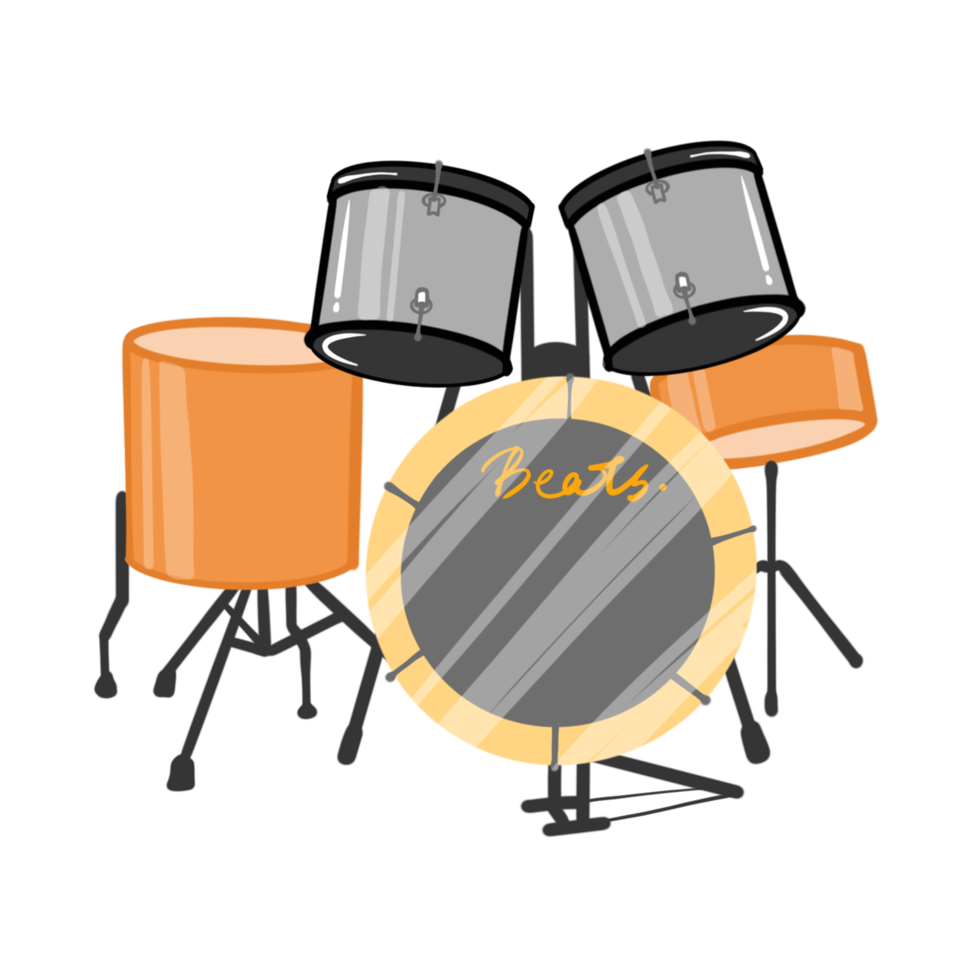


CONCEPT
I AM GROOVE is an automated
drum machine web application
Algorithmically generated patterns
Record your own sounds
Customize your groove
Enhance your creativity

Slide 3


CODE STRUCTURE
Flask Backend
For heavy weight computations
Written in python
react frontend
Responsive GUI
Modular and flexible structure

Slide 4
CODE STRUCTURE
State update
Frontend - backend
communication
Generated pattern

Slide 5
FRONTEND
App
Control panel
Performance panel
App.js is the main component
Calls the other components
Updates the state depending on them
Sends the state to the backend
Receives the pattern from the backend
Handles the counter for the reproduction

Slide 6
FRONTEND
App
Control panel
Performance panel
Sound channel
metronome
measure
Sound control
apm
cell
complexity

Slide 7
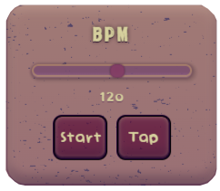
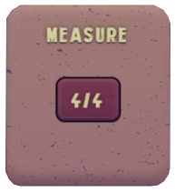


FRONTEND
Control panel
All the state updates happen within those four components
Their values are sent to the backend for the pattern customization algorithm

Slide 8
FRONTEND
Control panel
BPM
Can vary from 50 to 180 BPM
Has an independent play function
Can be set through either slider or tap tempo

Slide 9
FRONTEND
Control panel
measure
Odd signatures available
From 2/4 to 7/4
Dropdown component for the selection

Slide 10
FRONTEND
Control panel
Apm
Automatic Pattern Modulation
From 1 to 4 measure periodicity
Controlled with a step slider

Slide 11
FRONTEND
Control panel
complexity
Determines the complexity of the pattern
Influences the metric subdivision
Ranges continuously from 1 to 100

Slide 12
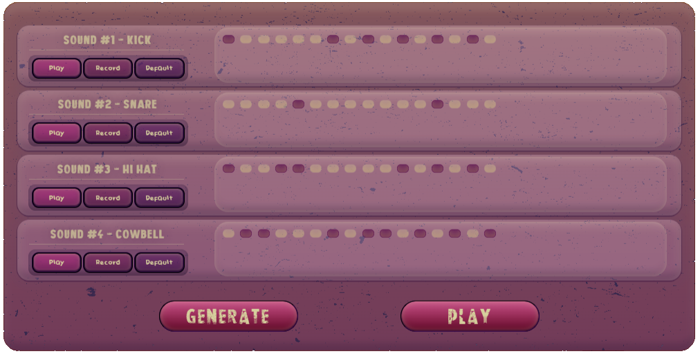
FRONTEND
performance panel
Receives information
from the backend
Four channels, each for a different sound
Generate pattern and Play buttons

Slide 13
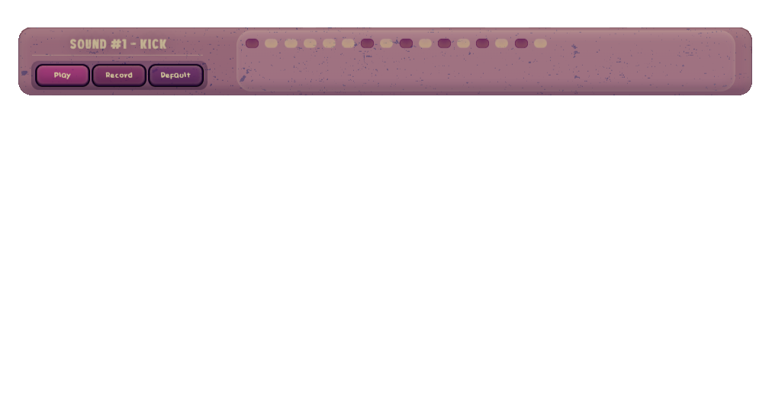
FRONTEND
performance panel
soundchannel
Represents a single row of the pattern grid
Associated with a specific instrument
SoundControl handles the instrument selection

Slide 14
FRONTEND
performance panel
Soundchannel - soundcontrol
Default sounds of kick, snare, hi hat and cowbell
User can record his own sounds
Switch between Default and User sound

Slide 15
FRONTEND
performance panel
Soundchannel - cells
Number of cells depends on the generated pattern
Play duration depends on measure subdivision
Active/inactive state change on click

Slide 16
BACKEND
Receives the state from the frontend (control panel)
Generates a pattern based on the current state at every call of APM or Generate button
Sends back to the frontend the generated pattern (performance panel)
Receives the recorded audios from the frontend
Trims the audios and saves them locally
Audio processing with librosa

Slide 17
BACKEND
Pattern generation
Complexity sets the metric quantum
Measure and Complexity set the number of cells
Generated as a string of booleans
Probability based rules
Kick and snare follow custom rules
Hi-hat and cowbell rely on Markov chain approach

Slide 18
Graphic user interface

Slide 19
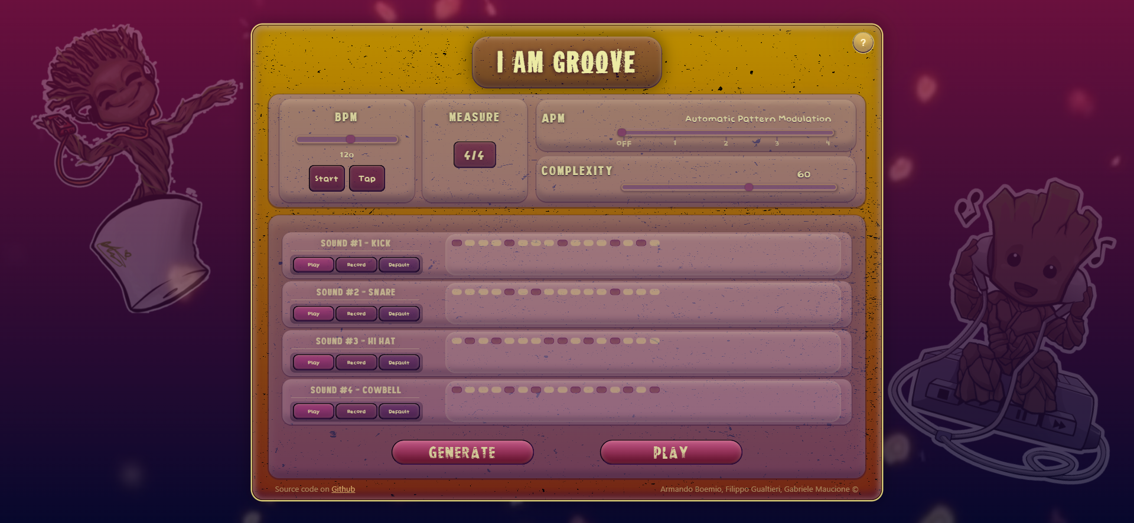

Slide 20
demo time!

Slide 21


Slide 22
Thanks!

